Slide 1
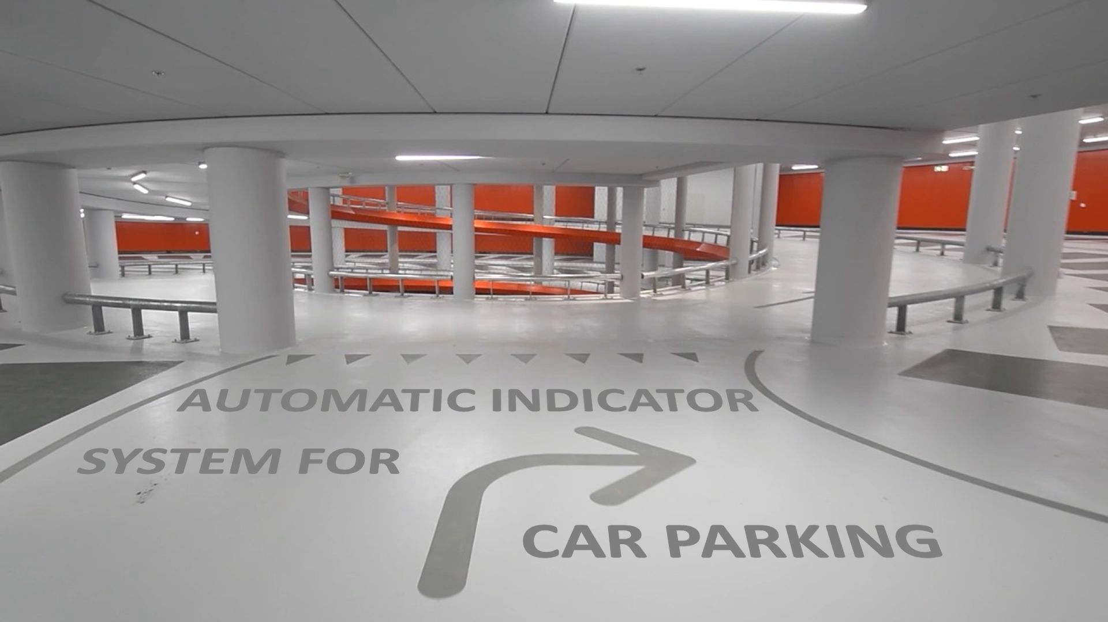

Slide 2
AUTOMATIC INDICATOR SYSTEM FOR CAR PARKING
Designed with DSP(Digital Signal Processing) & Image processing (Using MATLAB) for discovering a parking area for car efficiently in huge parking spots
VIJEET NIGAM

Slide 3
Content
Introduction & Need
Solution & Application
Project Brief
MATLAB CODE OUTPUT
Advantages
Other Ways to be Done
Real World Scenario

Slide 4
INTRODUCTION & NEED
Manually it is not an easy to find Vacant Car Parking Space in Large Areas.
With the problems of ever increasing urban traffic congestion and the ever increasing shortage of space, the parking lots need to be well-equipped with parking space detection.
So as to reduce human power, this system helps in counting the number of parked vehicles and, identifying the number of spots available with ZERO human interaction.

Slide 5
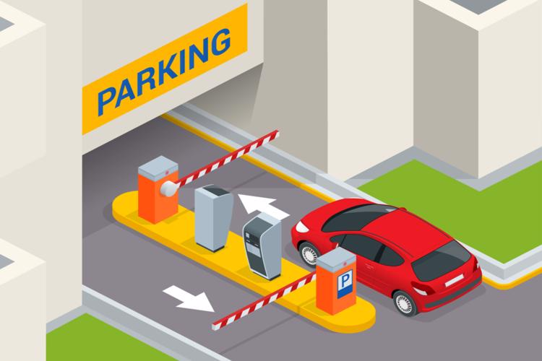
SOLUTION
The aim of this model is to build up and implement an automatic parking system that will detect the parking space with the help of image processing technique of the parking lot.
If such large parking area are handled manually, it would require a large no. of circuitry.
So as to reduce the no. of circuitry, such system is proposed.

Slide 6
APPLICATIONS
In busy towns and cities, parking management still poses a challenge that keeps growing more complex. This can be a solution to this problem.
Such Car Parking Systems are used in Malls, many offices/complexes.
Enable drivers to locate and reserve empty parking slot at the entrance and remotely. This should be provided by a small display panel at the entrance of the parking and near to every parking slot. It should show the parking number and the state of the parking.
Also such systems can help the user, if he/she has forget the parking lane no. Here already the user will be assigned a Lane no.

Slide 7
THE PROJECT
Lets assume, there is Commercial Complex which is having a 3 floor Basement Car Parking Space with a Capacity of 432 Cars – 144 Each Floor.
Camera gives the live top view image of the parking lot.
Whenever a Car enters, the computer processes that live top view image (using MATLAB) and finds the No. of vacant space available in the parking area. The system gives the details of exact location/ lane/ floor as OUTPUT.
Such Beneficiary project can also be used on more larger scale.

Slide 8
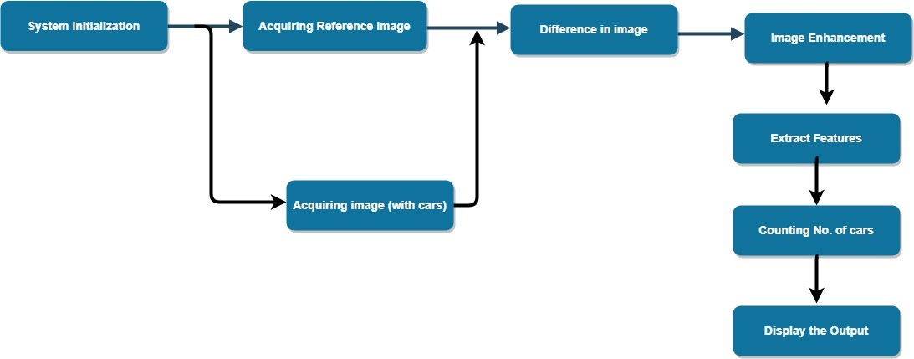
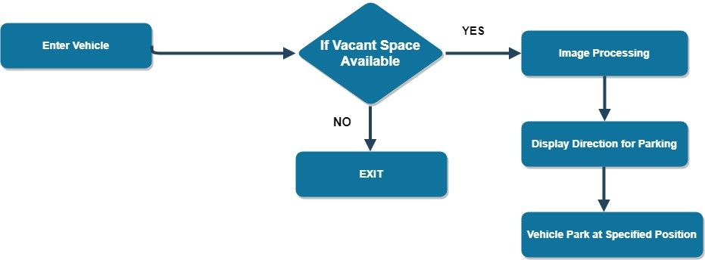
Main flow of the framework
CHECKING AVAIBILITY
Algorithm for Parking Space Detection

Slide 9
MATLAB CODE Functions
a=imread('C:\Users\Vijeet Nigam\Desktop\RGIPT - CSE\SEMESTER\sem ii\CSEP\PROJECT\cp32_1.jpg’); % 2nd Floor Live Parking Image
b=imread('C:\Users\Vijeet Nigam\Desktop\RGIPT - CSE\SEMESTER\sem ii\CSEP\PROJECT\cp32_blank.jpg’); % BG Parking Lot Image
m=imresize(b, [size(a,1) size(a,2)]);
d= imsubtract(m, a); % for Image Subtraction
f=im2bw(d, 0.1);
bw3 = imfill(f, 'holes’);
bw4 = bwareaopen(bw3, 10);
cars = bwconncomp(bw4);
d1 = cars.NumObjects; % for Counting No. of Objects
total = 144 - d1;
subplot(121); imshow(a); title('LIVE IMAGE OF PARKING LOT’);
subplot(122); imshow(bw3); title('COMPUTER PROCESSED IMAGE’);

Slide 10
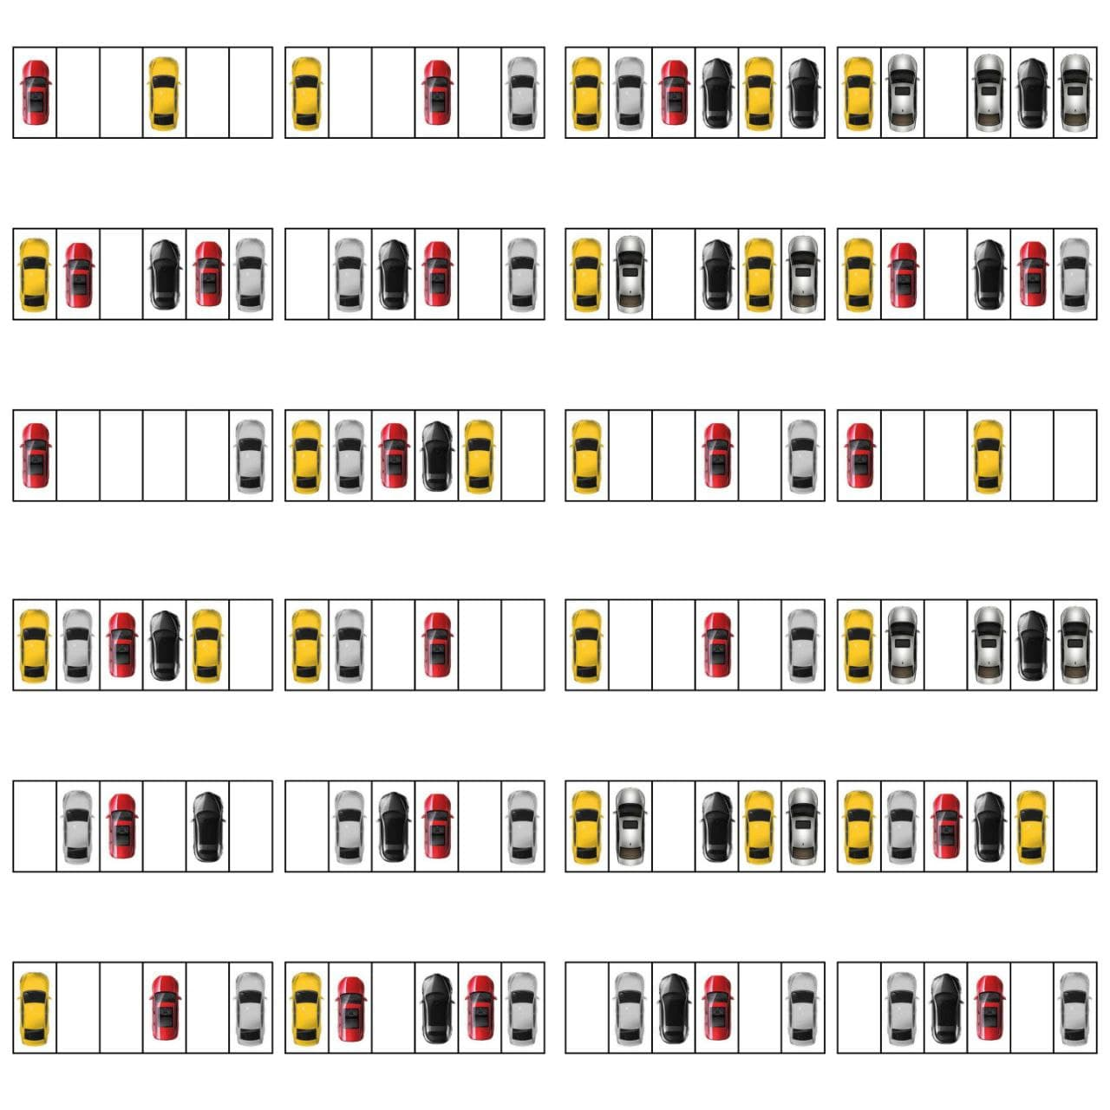
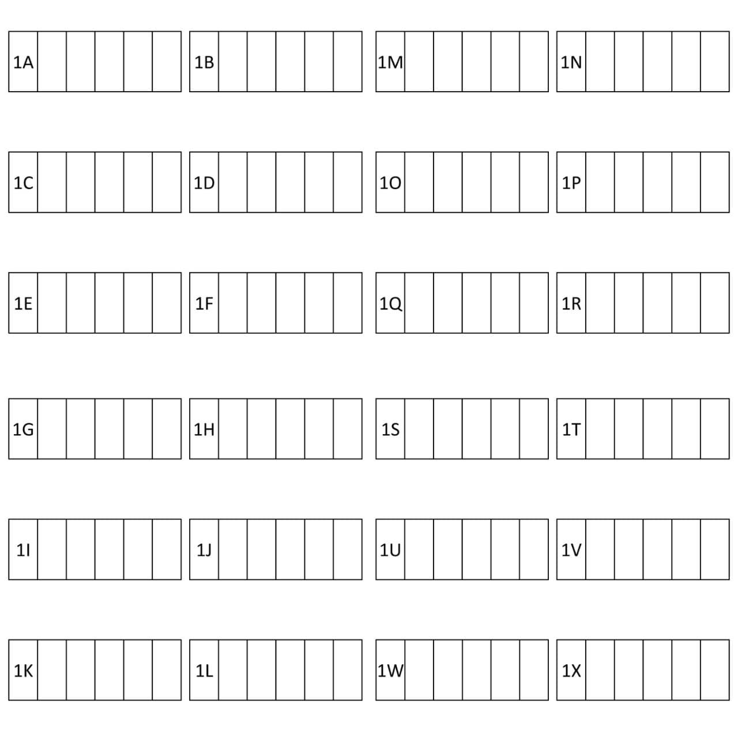
NOTE : According to the LIVE IMAGE OF PARKING LOT and the BACKGROUND IMAGE (Fig. above),the first position to fill the lane is LANE N which matches with OUTPUT.

Slide 11
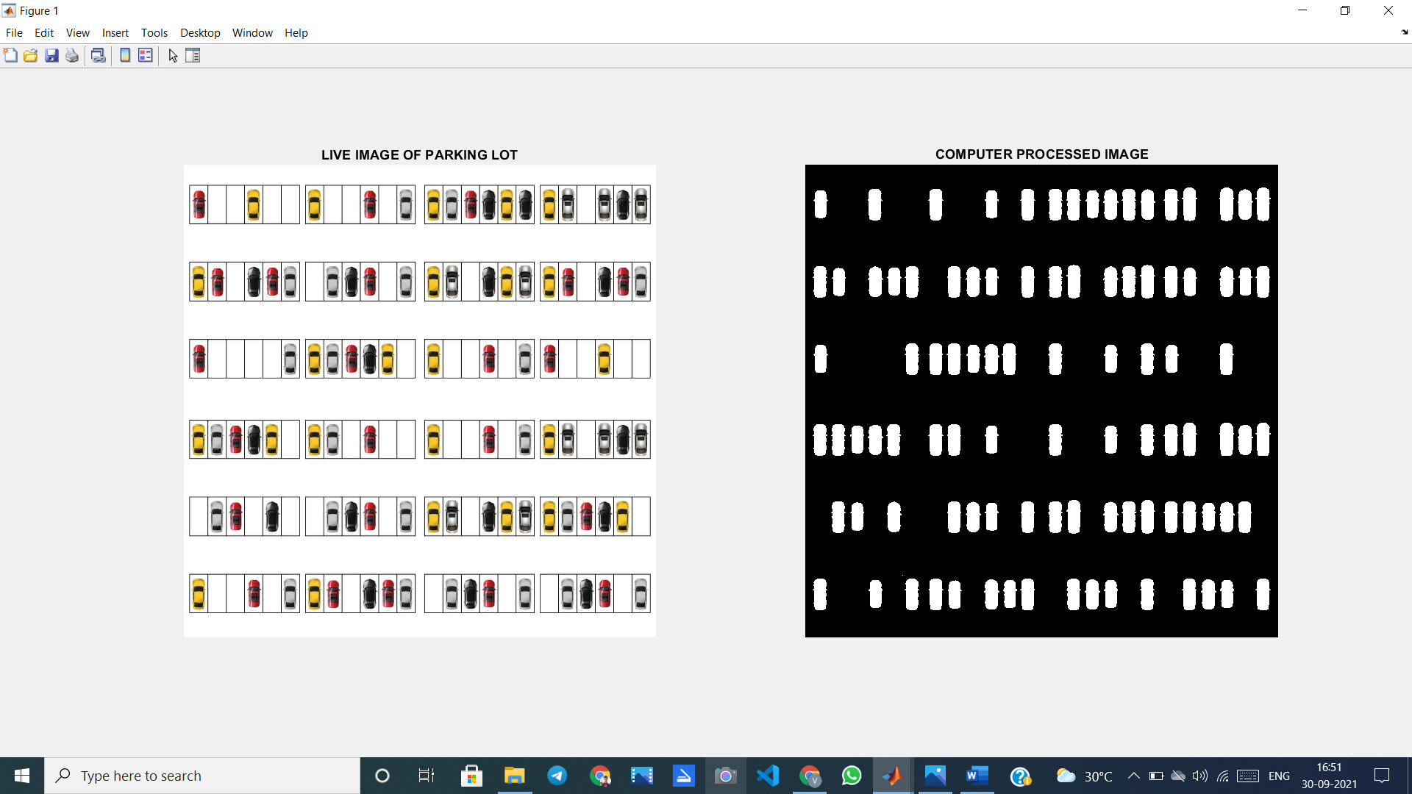
We get to know that 48 out of 144 Parking Spaces are Empty

Slide 12
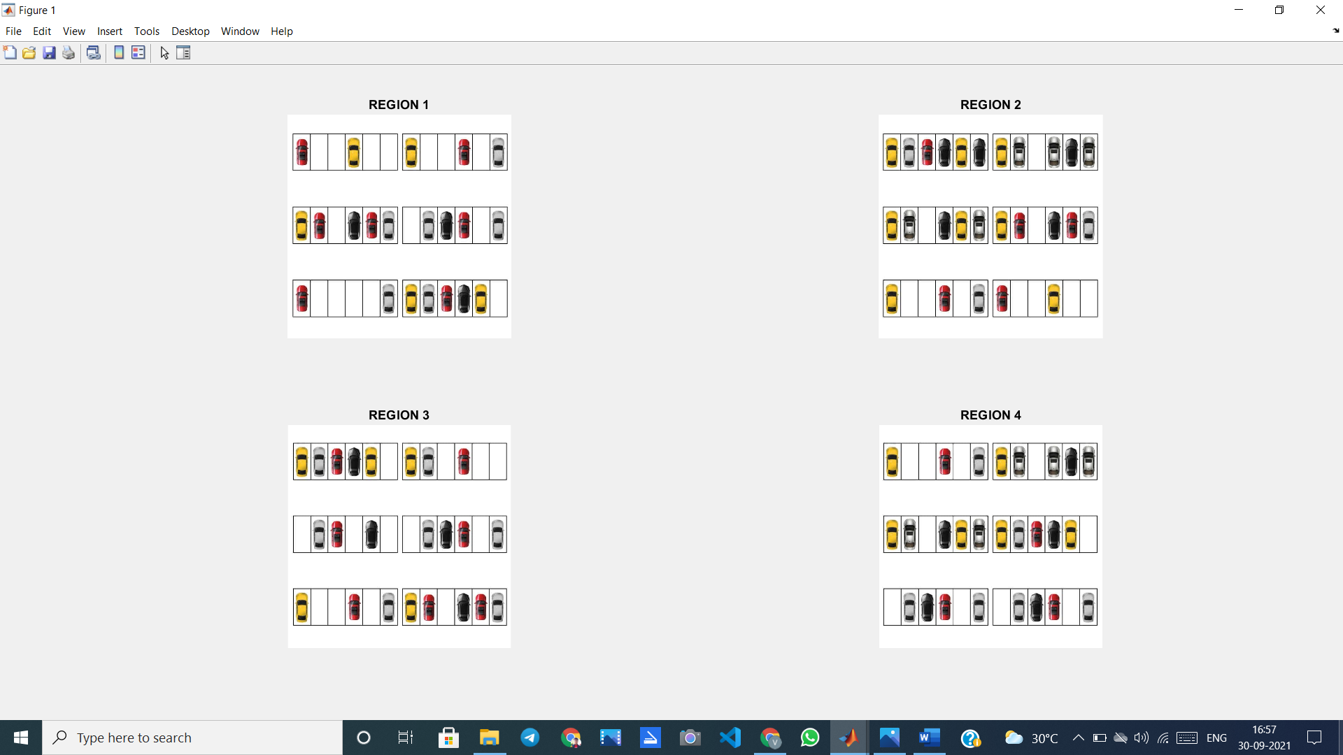
Further Calculating Parking Space among 4 Region by Image Division
REGION 2 have 10 vacancies

Slide 13
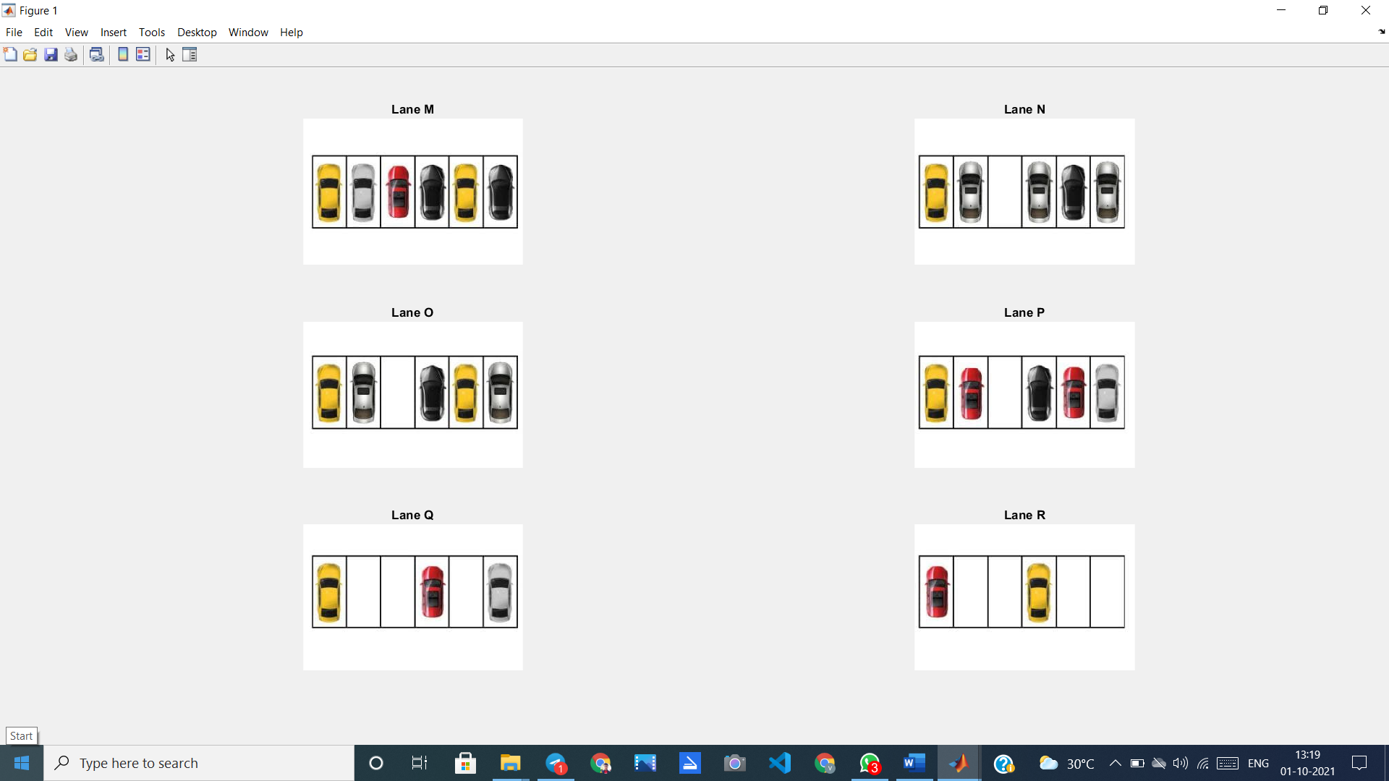
Image Division and Calculating for Appropriate Parking Lane that’s easy to Find & Park
Region N is closer to Entry Gate and has single Parking Space Available

Slide 14
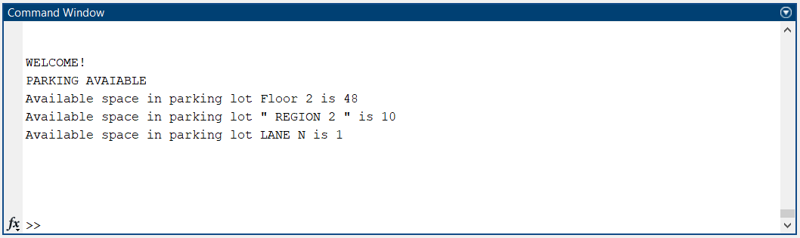
FINAL OUTPUT

Slide 15
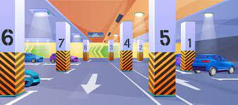
ADVANTAGES
Time Saving
Reduces Manual Work
Least Human Interaction
Cost Effective

Slide 16
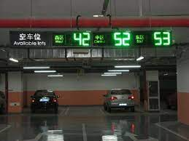
OTHER WAYS TO BE DONE
PLC Based Automatic Intelligent Car Parking System, that works on 3 modes such as ON, OFF and EMERGENCY.
This system developed is able to sense the presence of the vehicles standing at the main car parking gate through an IR sensor. These IR sensors give their output to the PLC (programmable logic controller).

Slide 17
OTHER WAYS TO BE DONE
This System can also be made using the Arduino Uno & IR Sensors. On ground Sensors may result in better accuracy. But this process is a bit costly. These sensors can be based on a variety of sensing technologies, the most commonly used are magnetometer, infrared, ultrasonic, and radar.
Programming of such model can be done using C++/C/Python, etc.

Slide 18

REAL WORLD SCENARIO
Most of large Parking Lots use PLC Based Automatic Intelligent Car Parking System in Real World Scenario.
Also, including Number Plate Detection in this system, the parking management will be totally computer technology based, where no human work would be involved.

Slide 19
